Slide 1
DISCOVERY ON TV PRESENTS SPEED XPERTS IN SPACE

Slide 2
Speed Xperts
Speed Xperts is a company of researchers working to improve aerodynamics in cars, aircraft and sports wear.

Slide 3
PLASBON
Last Year the Speed Xperts discovered Plasbon after a terrible fire in their lab. Two compounds became mixed and when the mixture cooled we discovered that everything underneath had been protected from fire and water damage. This material was found to have incredible insulation and resistance properties . It can be stored in liquid form but becomes an indestructible flexible film when air touches it. This discovery lead to some exciting new work for our researchers.

Slide 4
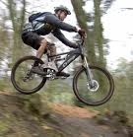
The Speed Xperts found that Plasbon makes fast things go even faster.

Slide 5
Getting the commission. We’ve been invited on a trip into space!

Slide 6
Mission Control to Galaxy Explorer. Are you ready for lift off?

Slide 7
Speed Xperts to Mission Control. We are ready for lift off.

Slide 8
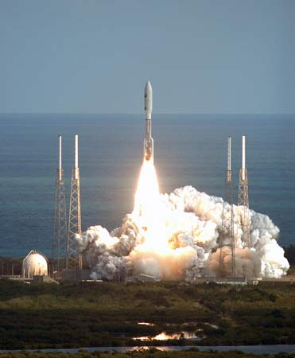
Mission Control to Galaxy Explorer, we have lift off.

Slide 9
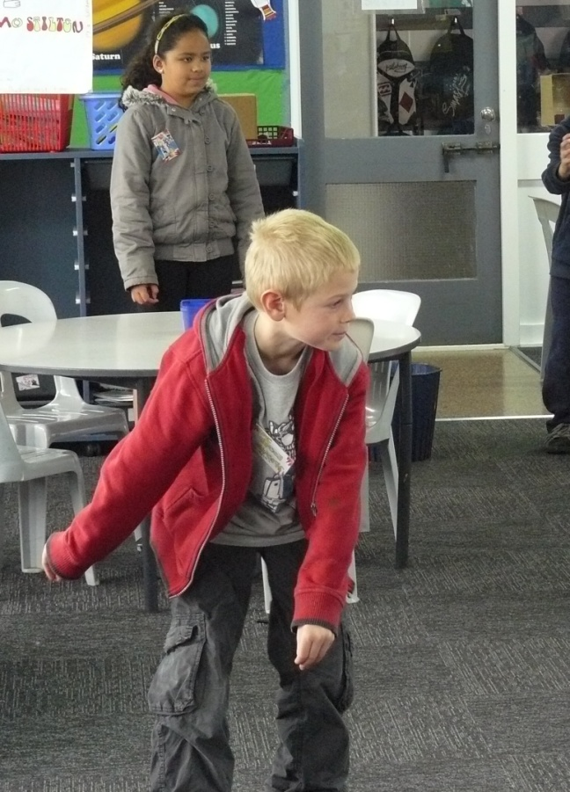
Living and working in space
The Speed Xperts have to learn about living in micro-gravity. Everything floats including us because things hardly weigh anything in space. Even unpacking our luggage from the storage place was fun.

Slide 10
One of the tasks we had to do in space was to keep a diary of what we did. Some of us wrote every day and some of us used video cameras.

Slide 11
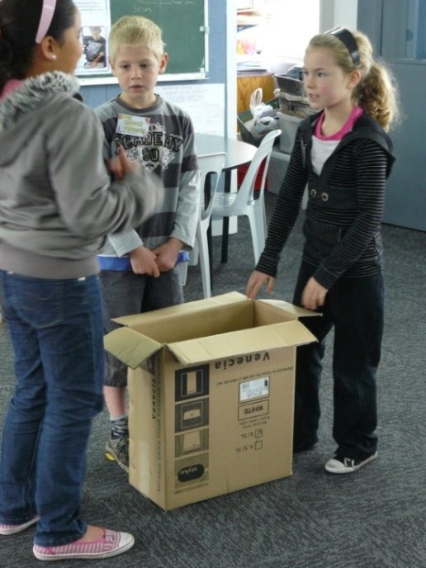
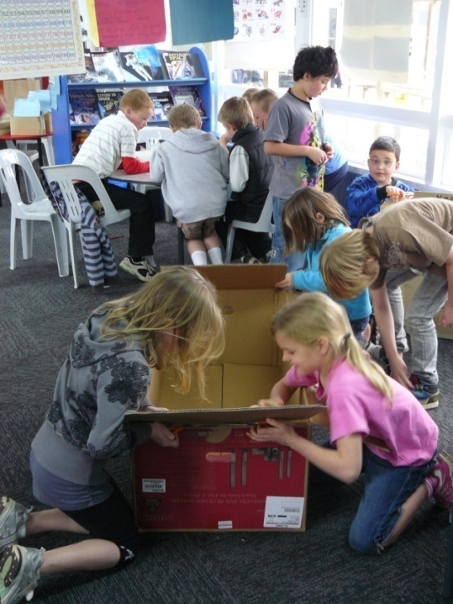
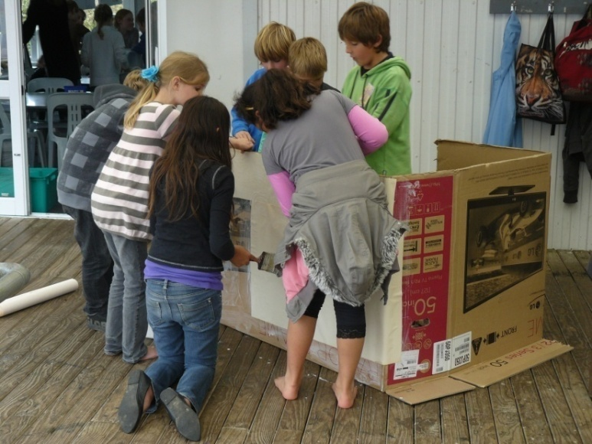
Problems to solve: Keeping clean Fixing equipment

Slide 12
What’s for dinner?
The food is packed in containers ready to rehydrate or heat.
You can float bubbles of water or pieces of food for fun.

Slide 13
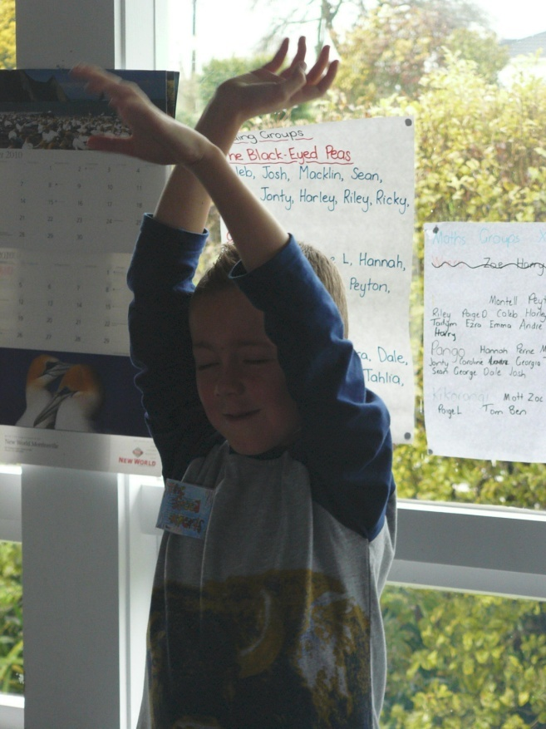
Where do you sleep?
Sleeping pods are comfy but you sleep on the wall!
Tuck your arms in your sleeping bag or they float.

Slide 14
Orbiting Mars the red, rocky planet.

Slide 15
Problem: Someone who fixed the Plasbon on Starscope didn’t seal it properly and a piece of the telescope has fallen onto Mars.

Slide 16
Programming Mars Rover to retrieve the telescope part.

Slide 17
To help the astronauts fix the telescope we had to find out how to use a robotic arm.

Slide 18
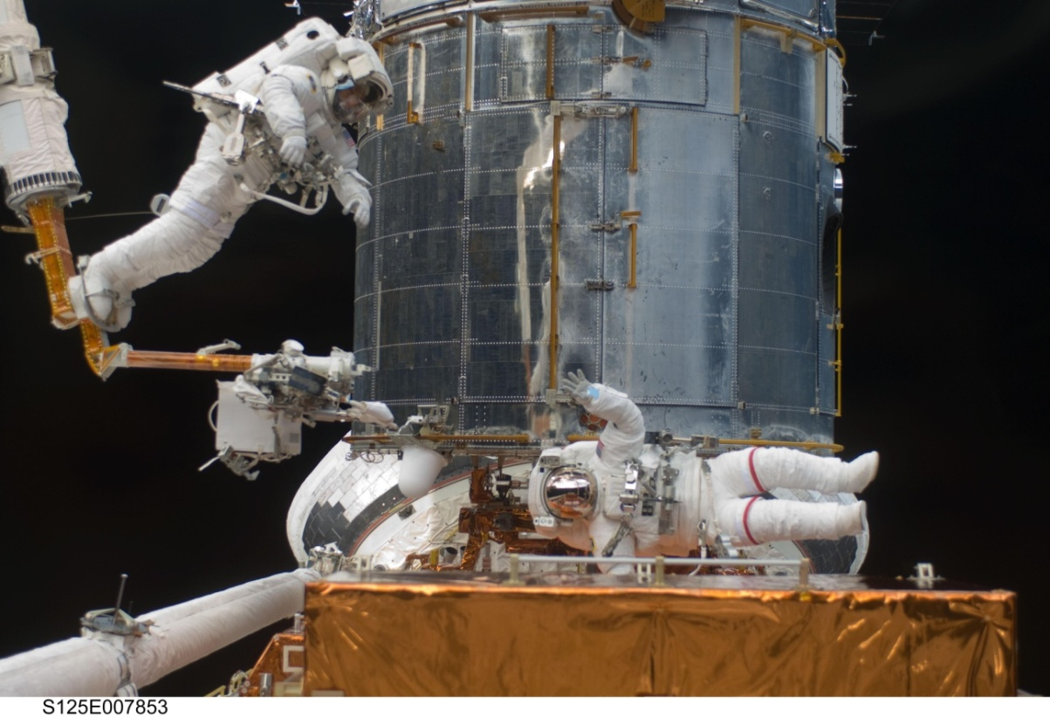
The astronauts fix Starscope.

Slide 19
A dying star that we saw through Starscope.

Slide 20
Seats, helmets and seat belts fixed. We’re ready for re-entry.

Slide 21
The end of our adventure
Our trip to space was so fun! We were sad to get back home. We learnt a lot that we didn’t expect to about what it’s like to live in micro-gravity. We didn’t learn much about planets and that’s what we thought we would find out about.
After we had got back we put our diaries and videos together into TV documentary for Discovery on NZ TV. Our friends and families got to see us putting all our work together and they thought it was excellent.

